Slide 1
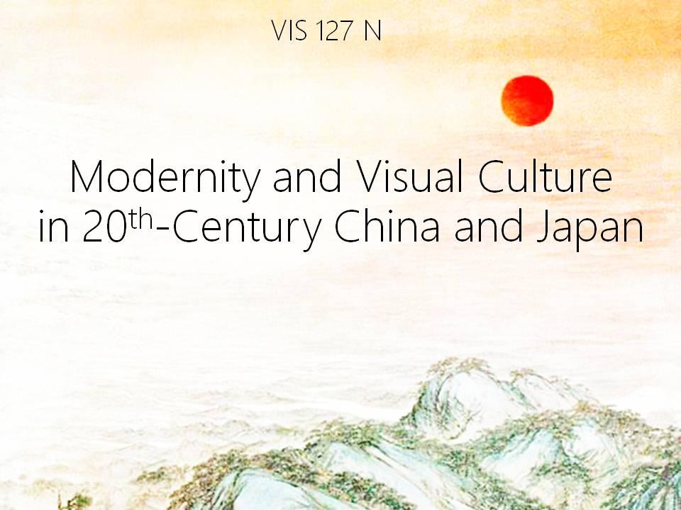

Slide 2
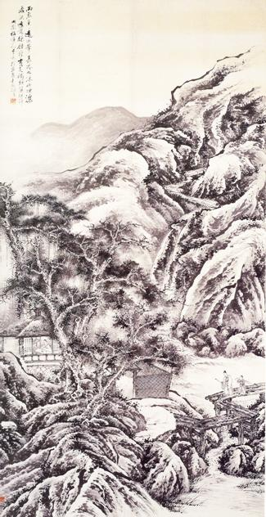
Hu Zhang
(1848 – 1899),
Taking a Qin on a Visit
to a Friend,
n.d.

Slide 4
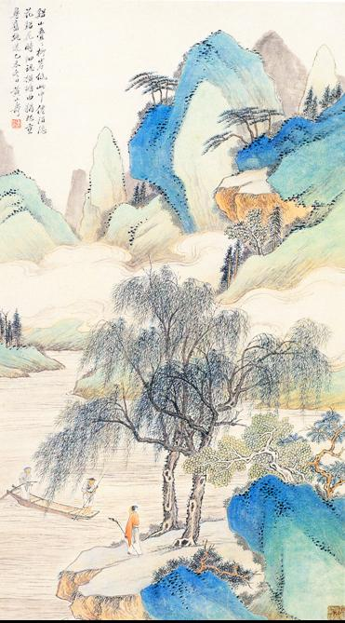
Hong Shanshou
(1855 – 1919),
Blue and Green Landscape,
1895,

Slide 6
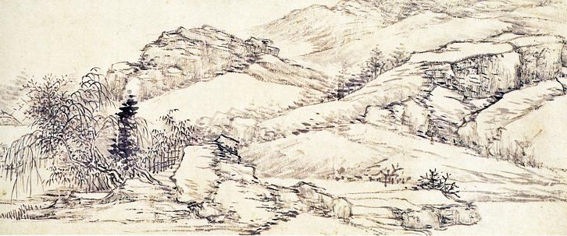
Ren Yu (1853-1901),
Landscape, n.d.

Slide 8
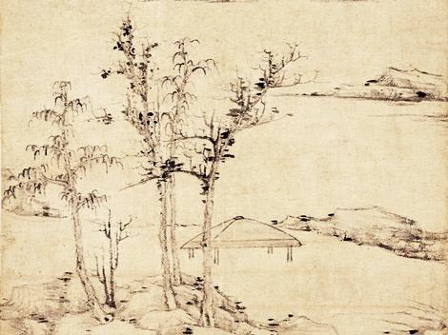
Ni Zan (1301-1374),
The Rongxi Studio, 1378

Slide 11
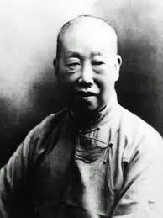
Wu Changshuo
1844 - 1927

Slide 12
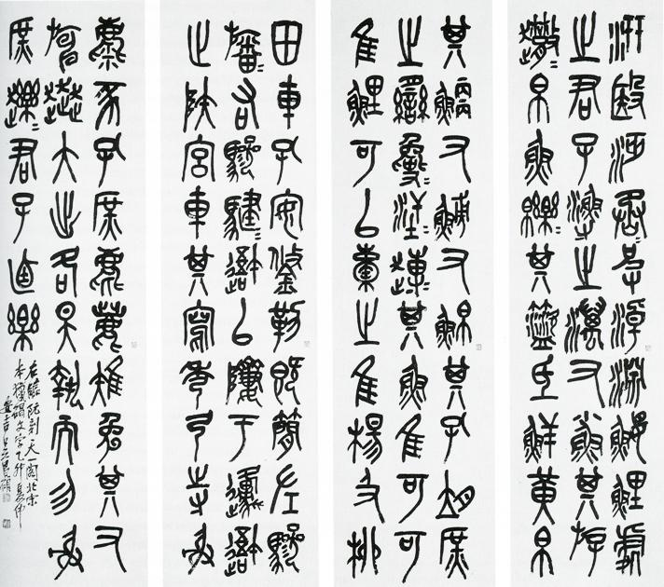
Wu Changshuo,
Stone Drum Script, 1915

Slide 14
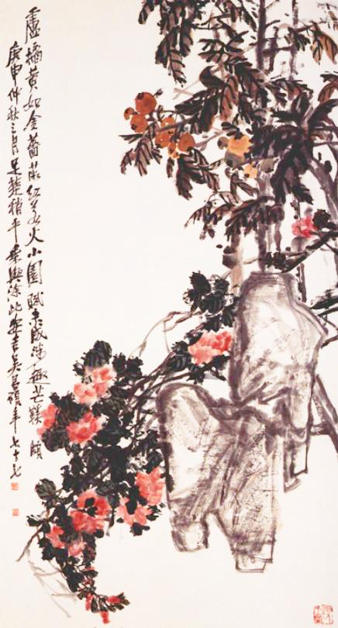
Wu Changshuo,
Wild Roses and Loquats,
1920

Slide 16
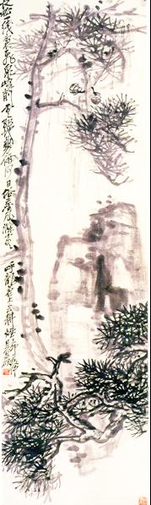
Wu Changshuo,
Pine and Rock,
1927

Slide 18
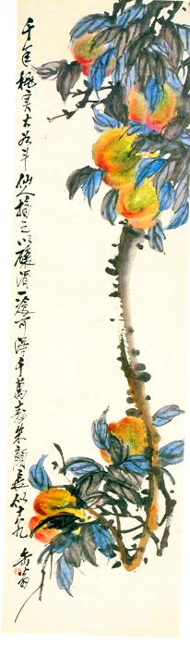
Wu Changshuo,
Peaches on a Bough,
n.d.

Slide 20
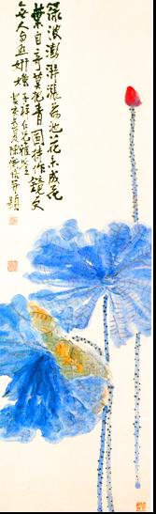
Chen Hengque
(1876 – 1923),
Lotus,
1923

Slide 22
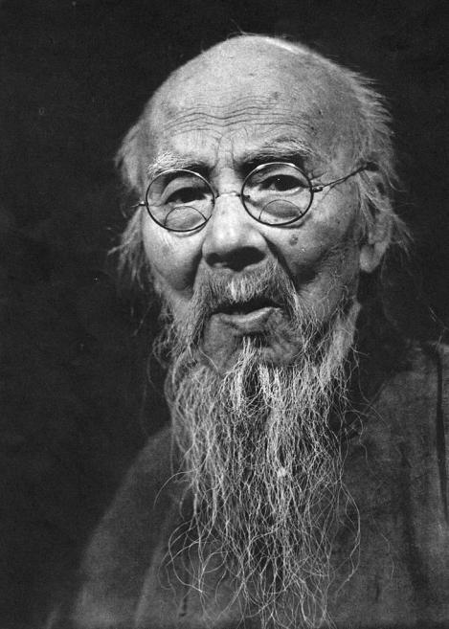
Qi Baishi
1864 - 1957

Slide 23
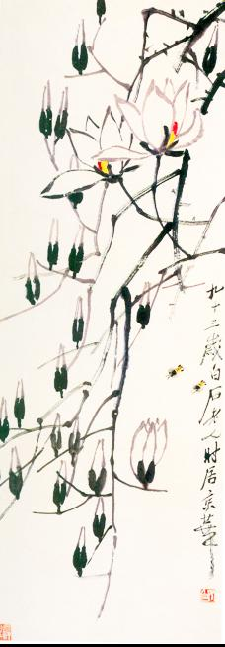
Qi Baishi
(1853 - 1957),
Magnolias and Bees,
1955

Slide 25
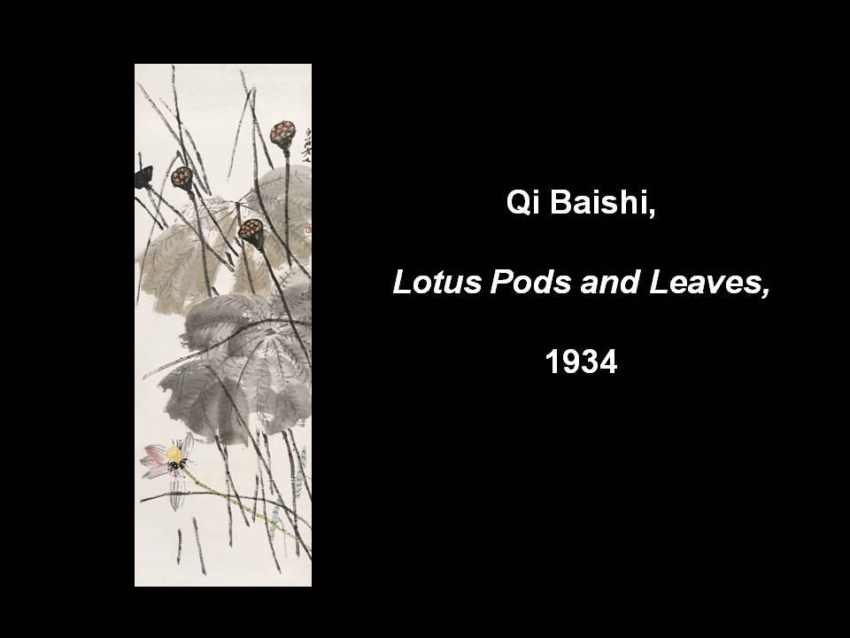

Slide 26
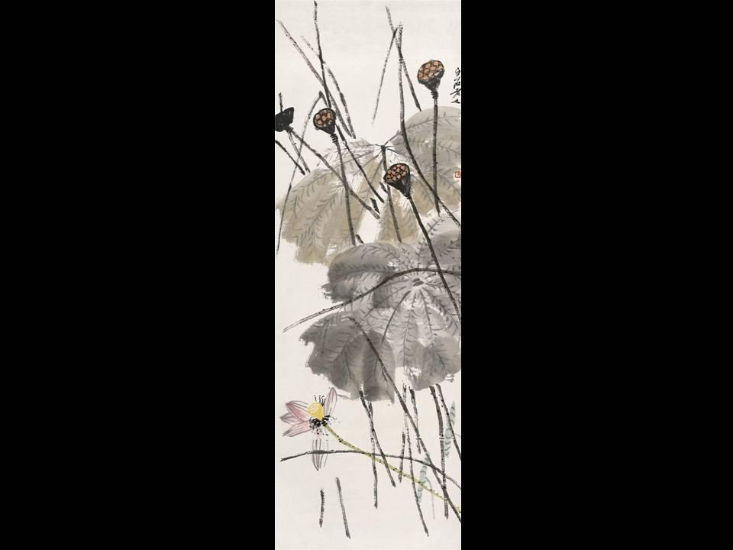

Slide 27
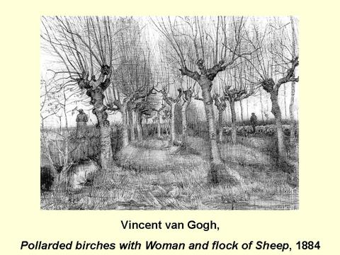

Slide 28
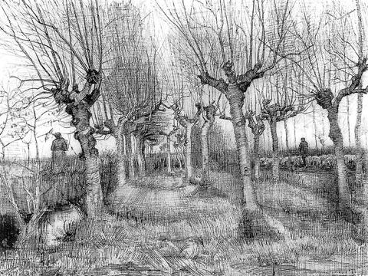

Slide 29
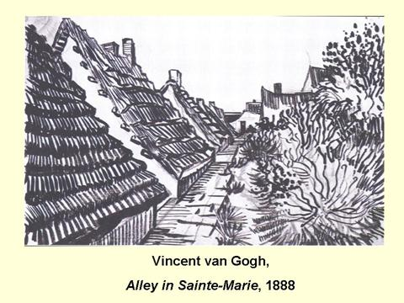

Slide 30
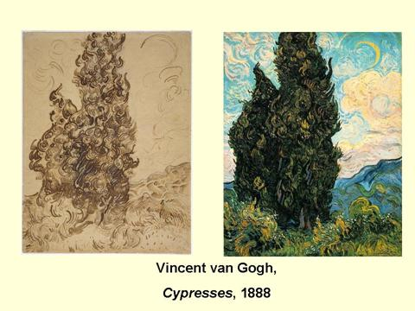

Slide 31
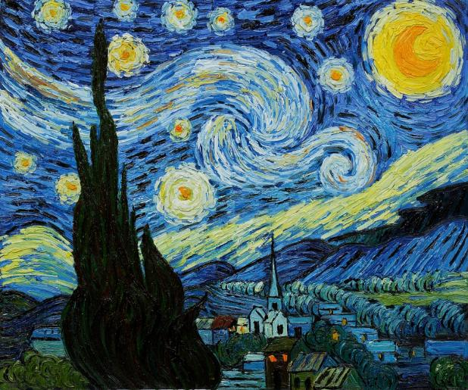
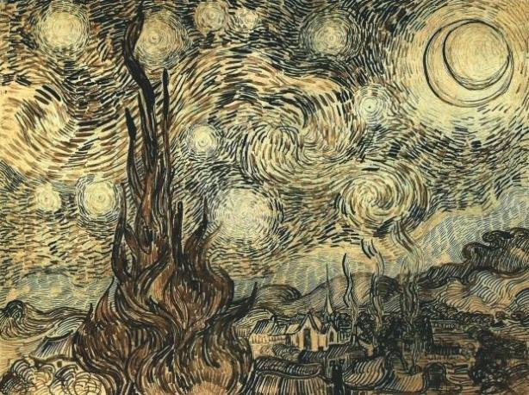
Vincent van Gogh, The Starry Night, 1889

Slide 32
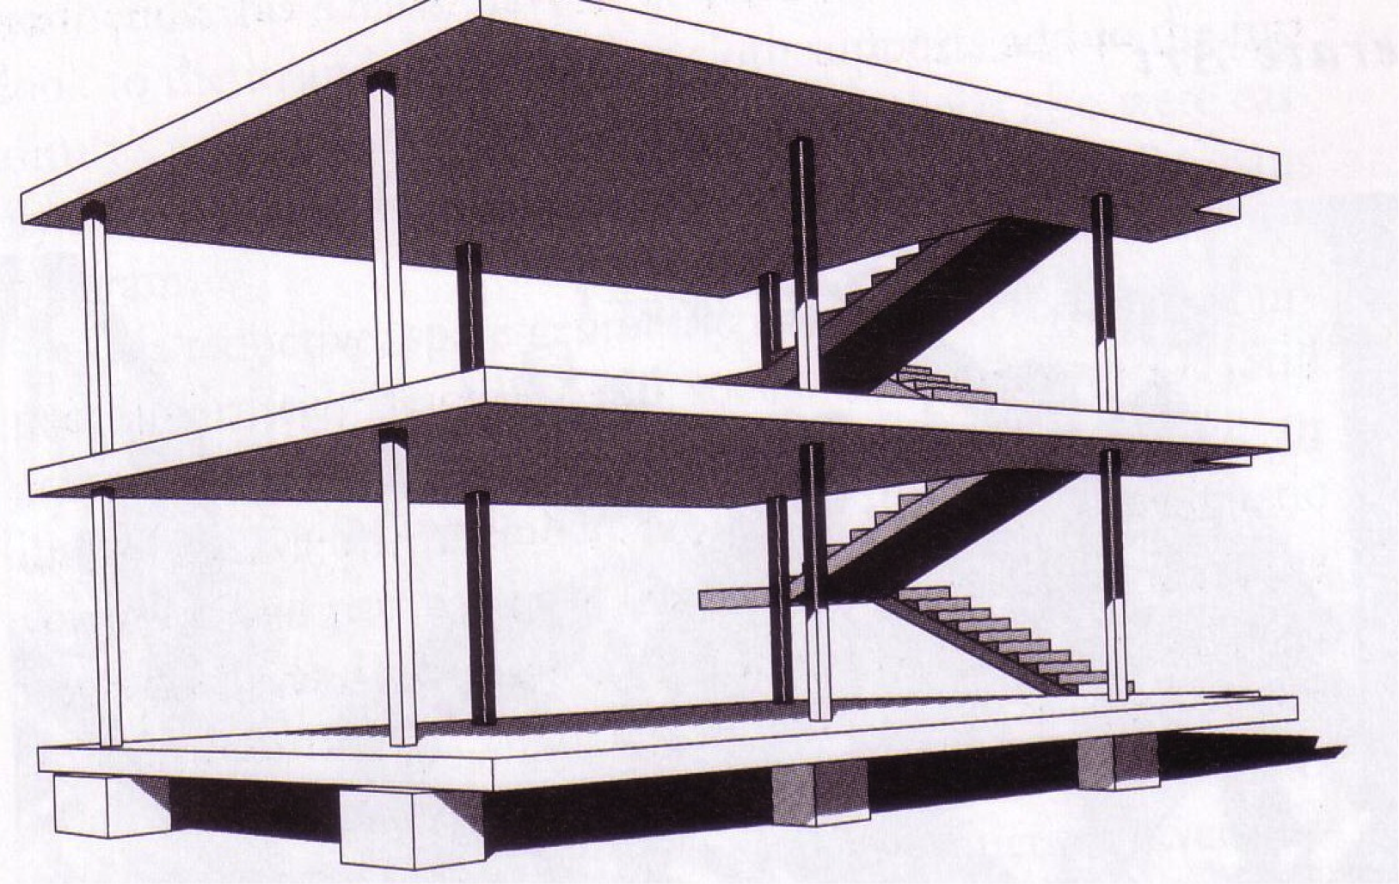
Le Corbusier, Domino House, 1917

Slide 33
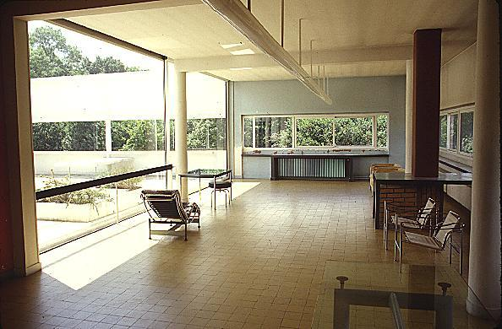
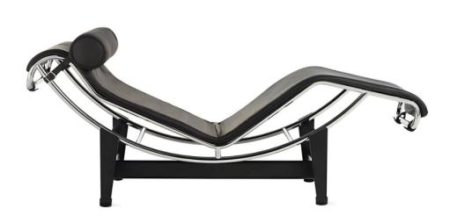
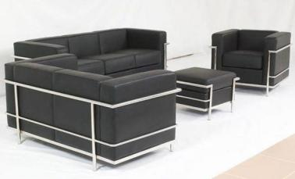

Slide 34
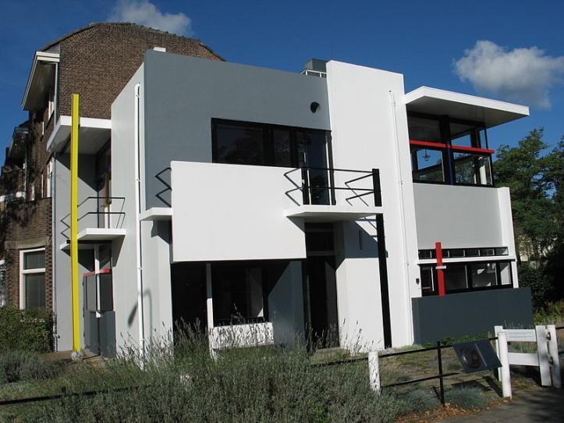
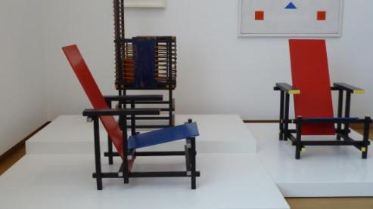
Gerrit Rietveld,
Schröder House, 1924
Chair, 1917

Slide 35
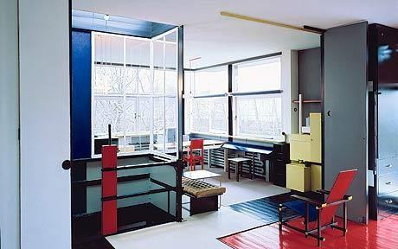
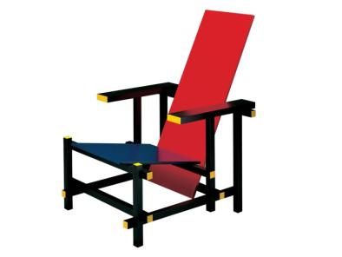
Gerrit Rietveld,
Schröder House, 1924
Chair, 1917

Slide 36
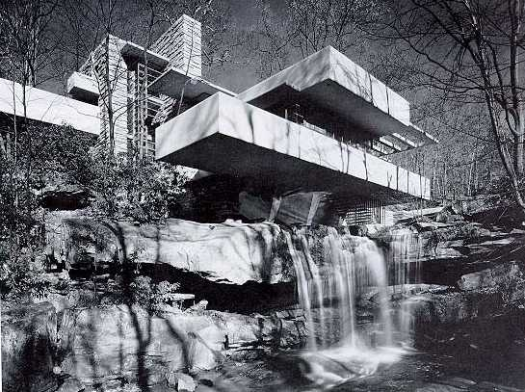
Frank Lloyd Wright, Falling Water, 1935

Slide 37
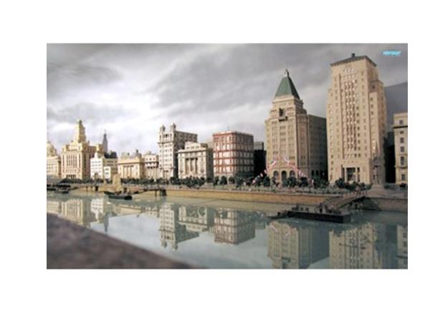

Slide 38
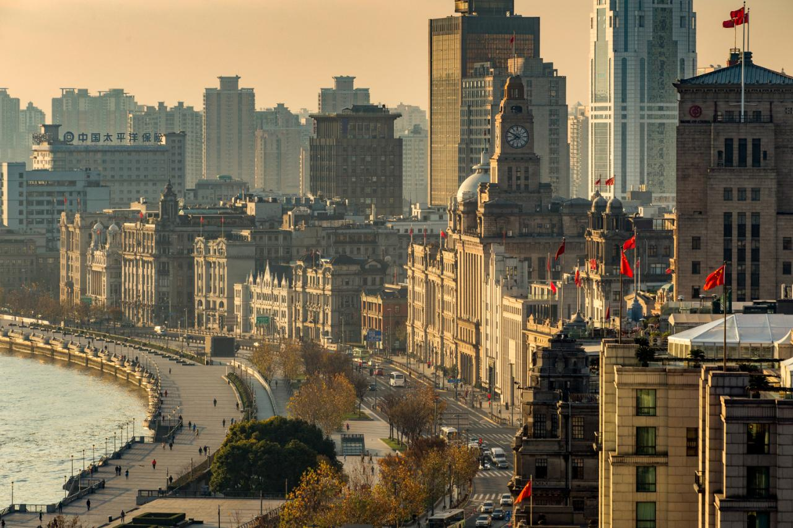

Slide 39
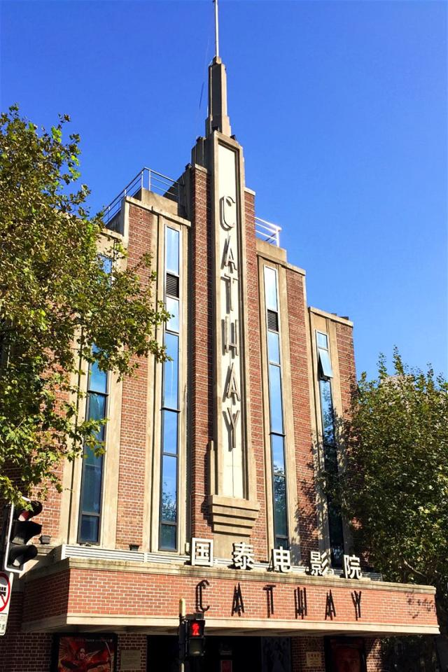

Slide 40
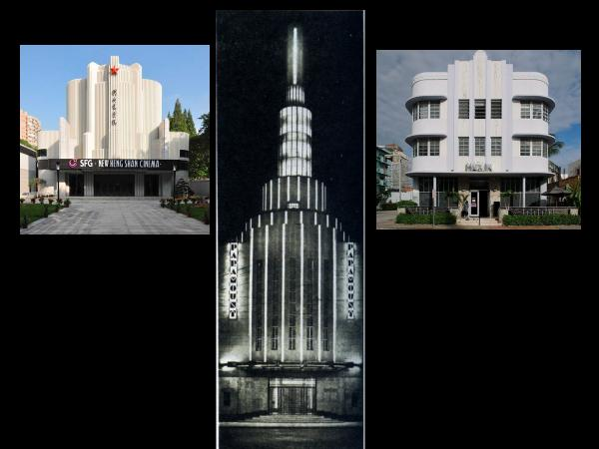

Slide 41
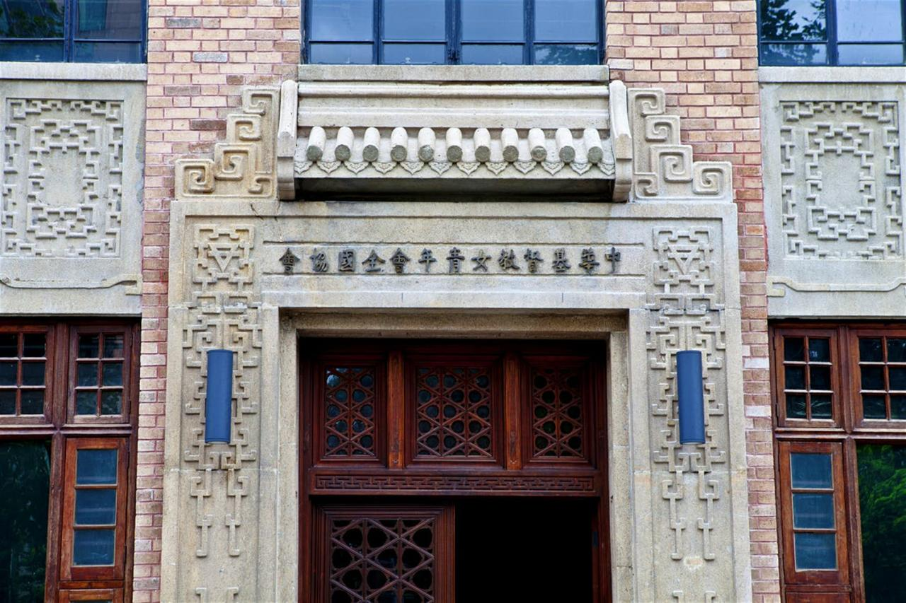

Slide 42
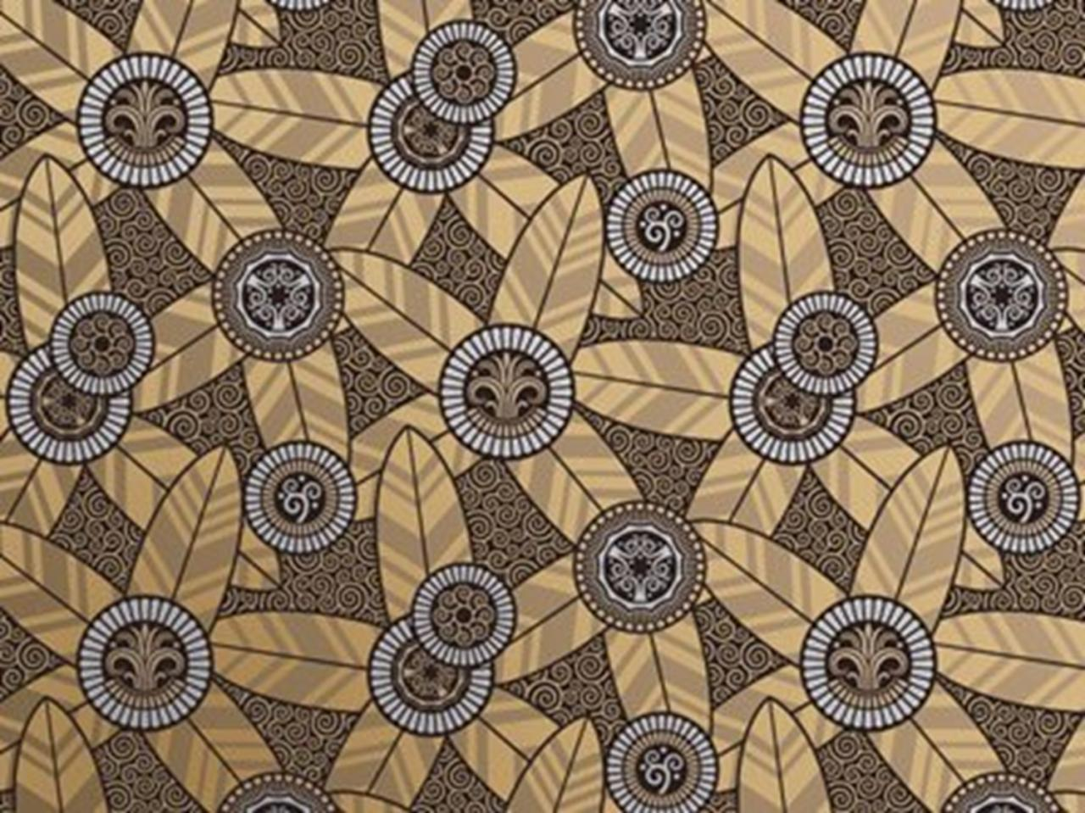

Slide 43
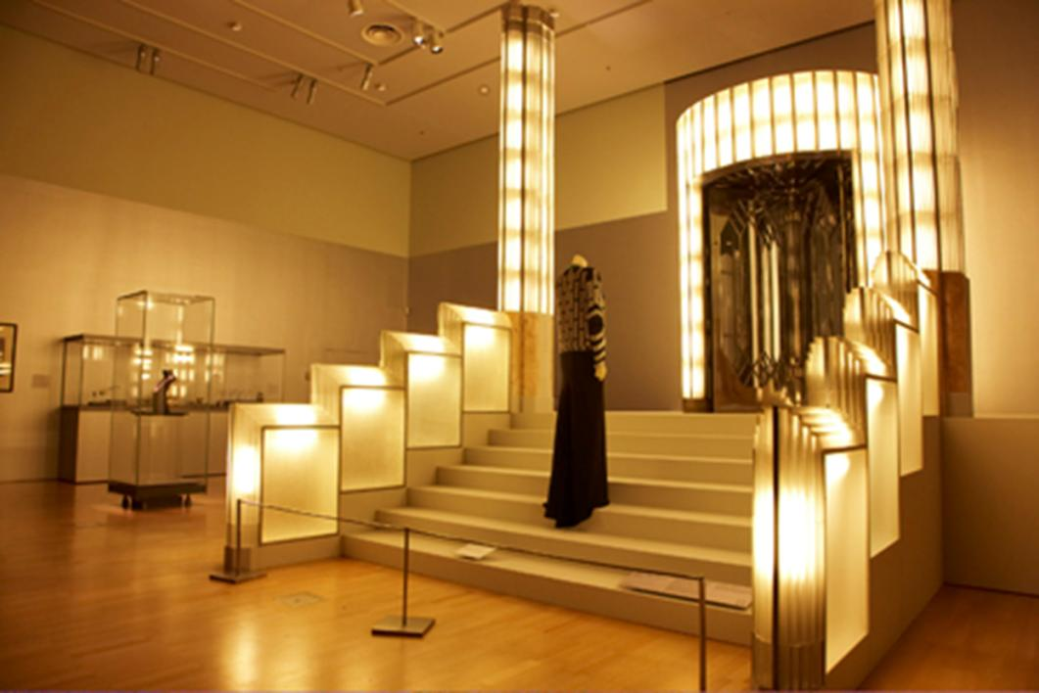

Slide 44
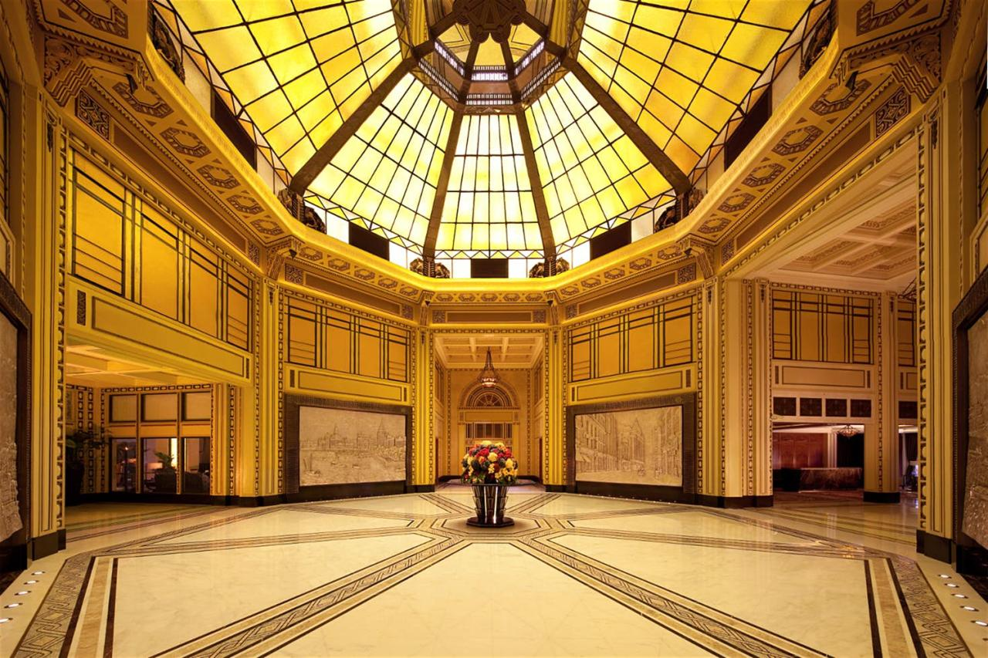

Slide 45
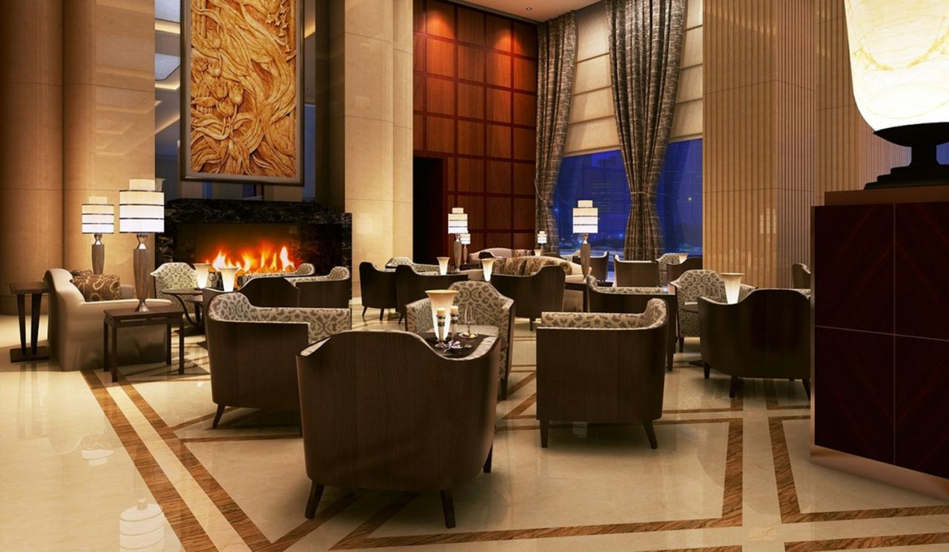

Slide 46
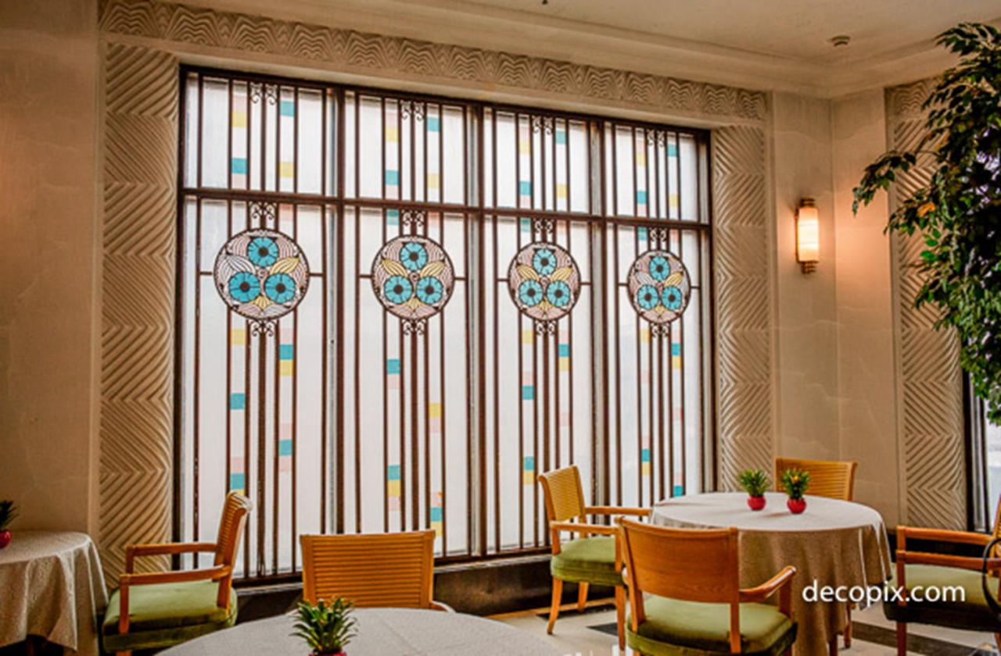

Slide 47
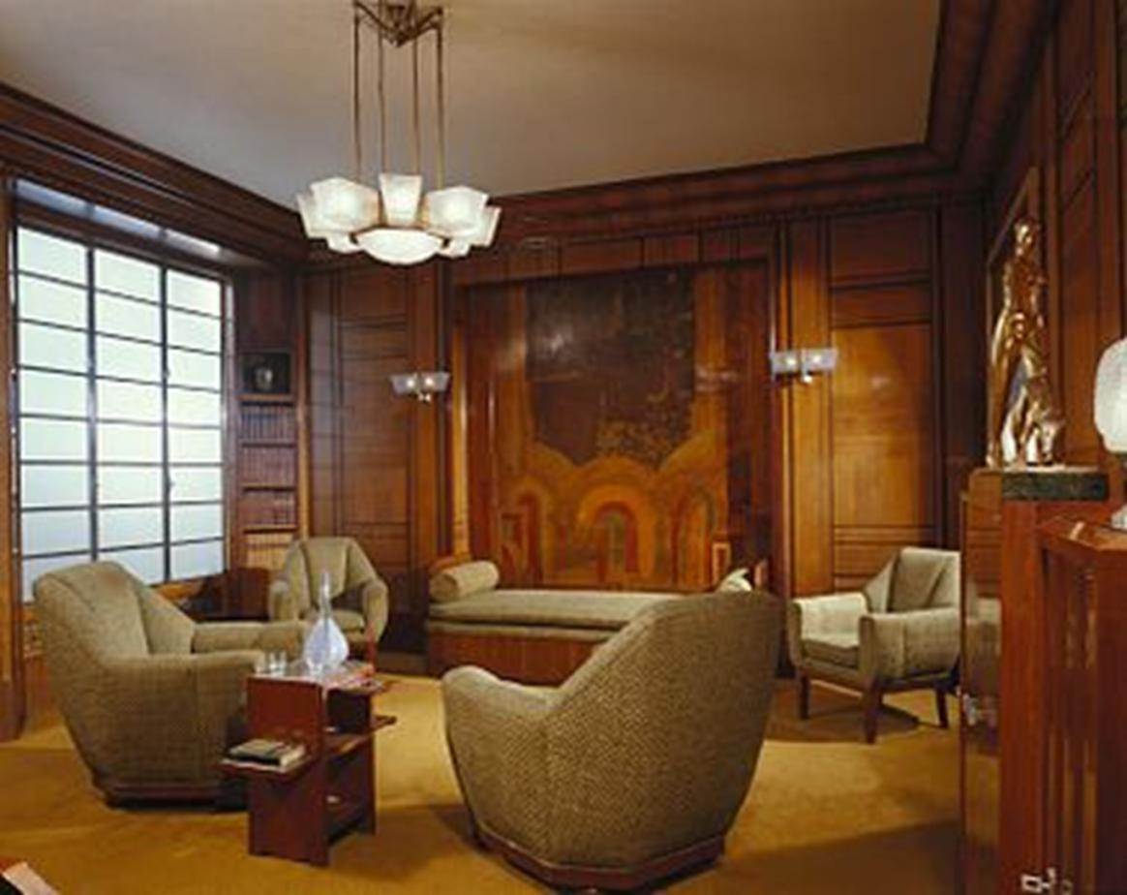

Slide 48
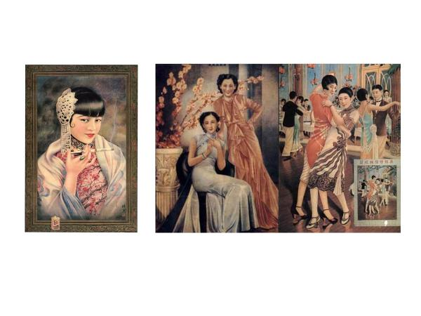

Slide 49
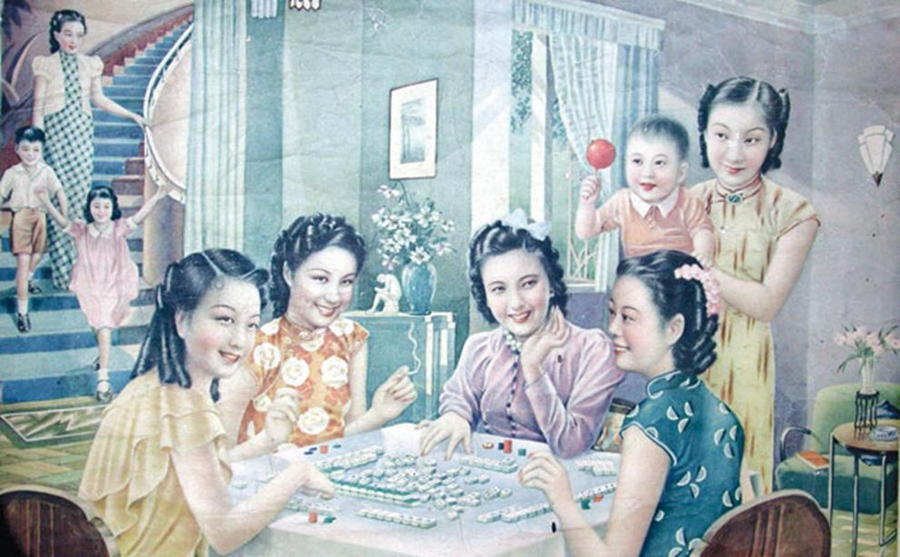

Slide 50
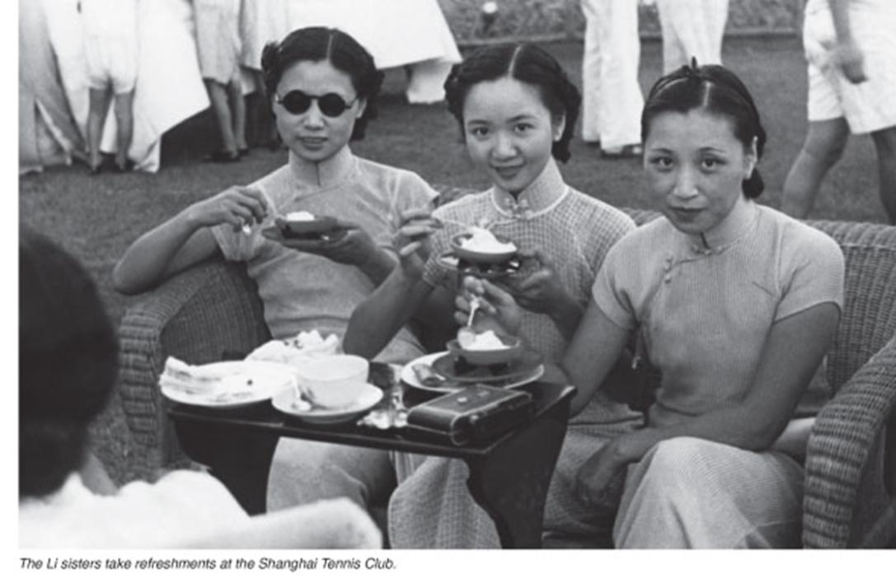

Slide 51
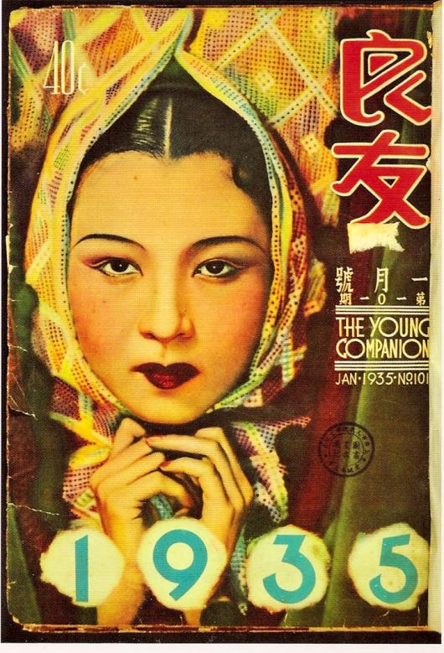

Slide 52
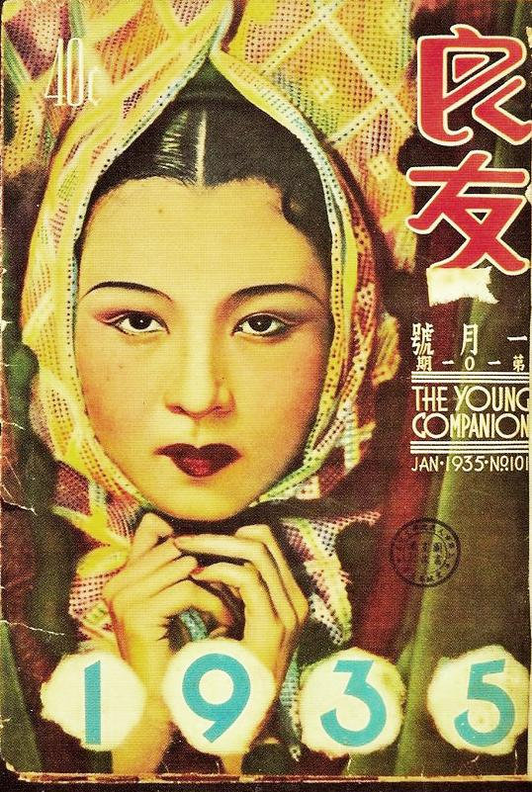
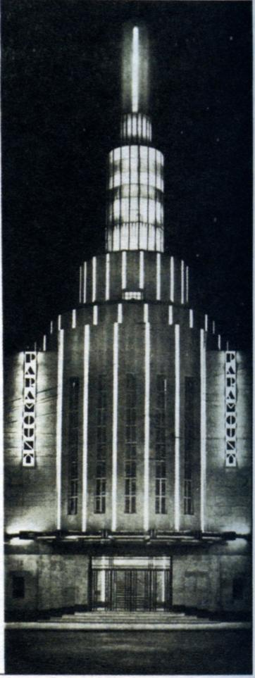

Slide 53
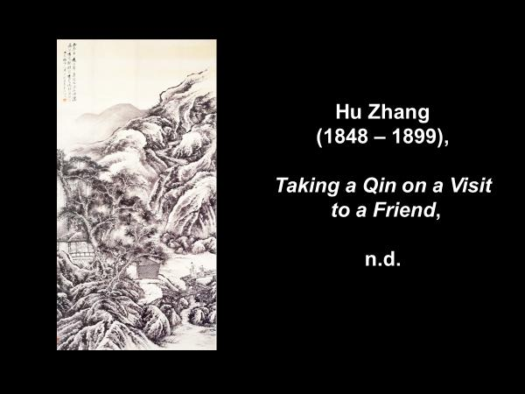

Slide 54
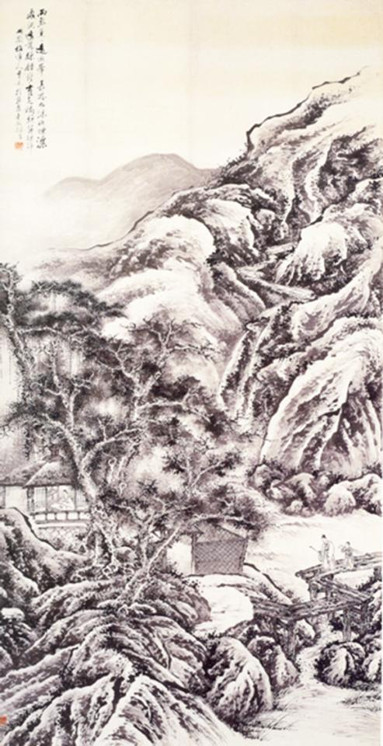

Slide 55
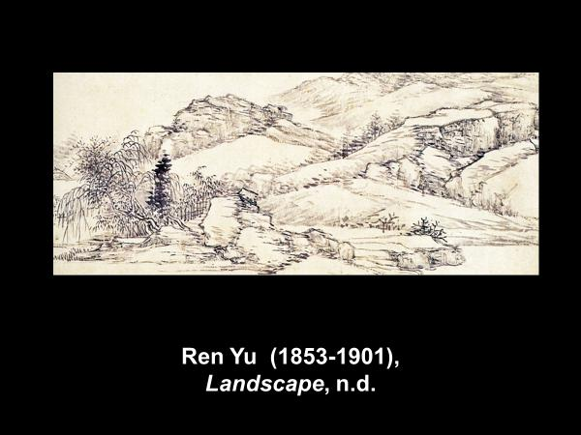

Slide 56


Slide 57



Slide 58


Slide 59

Wu Changshuo,
Chrysanthemums
and Rocks,
1917

Slide 60


Slide 61

Qi Baishi,
Shrimp,
n.d.

